Slide 1
SANTA CLARA

Slide 2
Developing with .NET Core on AWS
MAD306
Norm Johanson
Senior Software Developer Engineer
Amazon Web Services Twitter: @socketnorm

Slide 3
What’s new for .NET on AWS

Slide 4
Latest .NET Releases
ASP.NET Core Identity Provider for Amazon Cognito – General Available
https://aws.amazon.com/blogs/developer/now-generally-available-the-asp-net-core-identity-provider-for-amazon-cognito/
AWS X-RAY Support – General Available
https://aws.amazon.com/blogs/developer/aws-x-ray-support-for-net-core-is-ga/
AWS SDK for .NET updated to .NET Standard 2.0
https://aws.amazon.com/blogs/developer/aws-sdk-for-net-now-targets-net-standard-2-0/

Slide 5
AWS Lambda Layer Support for .NET Core
Include .NET assemblies in layer to reduce deployment bundle size
Option to pre-jit .NET assemblies to improve cold start
https://github.com/aws/aws-extensions-for-dotnet-cli/tree/master/src/docs/Layers.md

Slide 6
AWS Lambda .NET Core Custom Runtime Support
Deploy .NET Core 2.2 or 3.0 Lambda functions
Amazon.Lambda.RuntimeSupport NuGet package
Package as a self contained application
https://aws.amazon.com/blogs/developer/announcing-amazon-lambda-runtimesupport/

Slide 7
.NET Core AWS Lambda Tools
.NET Core Global Tool: Amazon.Lambda.Tools
Cross platform command line tool
https://github.com/aws/aws-extensions-for-dotnet-cli
AWS Toolkit for Visual Studio
Upcoming release for Visual Studio 2019
https://aws.amazon.com/visualstudio/

Slide 8
Modern .NET applications on AWS

Slide 9
Simple Elastic Mosaic Processing Application
What does it do?
How was it built?
What services were used?
What problems were solved?

Slide 10
What are we going to learn?
Modern application architecture using serverless and containers
AWS Lambda debugging techniques
Use AWS Lambda Layers
Using new AWS extension libraries in our application
CI/CD with the AWS Code services

Slide 11
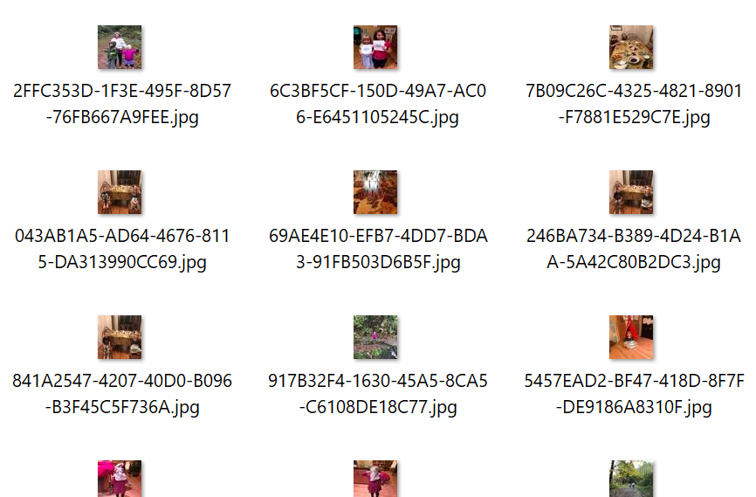



What is a mosaic image?
+
Tile Gallery

Slide 12



Overall architecture
Application
Tile Data
Mosaic tile gallery
ingestion
Upload tile gallery images
Processed Tiles
Tile Gallery
Tiles
Mosaic rendering
Upload image file
Output mosaic

Slide 13
Mosaic tile gallery ingestion

Slide 14
What does tile ingestion do?
Accepts zip file from user containing multiple images
Analyzes each image to create tile information
Resizes each image and save as a tile in a named gallery

Slide 15







How tile ingestion works
Tile images (zip)
Image moderation
Job queue
Process image
Image upload
Tile color data
Tile storage
Container image

Slide 16


Why did we choose AWS Batch?
Job definition
Job queue
Take advantage of serverless
Manages the compute capacity for us
Work can be queued for asynchronous processing
Tile creation is not a time critical task
Cost savings
No charge for idle compute environments
Ability to use Amazon EC2 Spot Instances
Job 1
Job 2
…
Job N
Compute environment
Spot Instance(s)
On-demand Instance(s)

Slide 17
Demo: Tile ingestion

Slide 18
What did we learn?
Using Dead-Letter Queues to help diagnose failures
Using the AWS .NET Mock Lambda Test Tool to replay and debug events
Using AWS .NET Core Global Tools in CI/CD pipelines
How to use AWS Batch

Slide 19
Mosaic rendering

Slide 20
What does mosaic rendering do?
Accepts an image file from the user and name of a tile gallery
Analyzes the image against the tile data in the gallery
Builds mosaic image using the matched tiles

Slide 21


How mosaic rendering works
Input image
Tile data
Output Mosaic
Trigger (API call or event)
Small render
Subscribers
Color map
Select tiles (F#)
Medium render
Completion notification
Large render

Slide 22
Demo: Mosaic rendering

Slide 23
What did we learn?
How to use AWS Step Functions to orchestrate a workflow
How to deploy multiple projects with a serverless template
How to use AWS Lambda layers with .NET Core AWS Lambda Functions

Slide 24
Web front-end

Slide 25
What does the web front-end do?
Allows an authenticated user to:
Create new tile galleries
Upload an image to create a mosaic

Slide 26


How the web front-end works
Web server clusters
Tile import
Render mosaic
Image file
User pool
Container image

Slide 27
Demo: Hosting the web front-end

Slide 28
What did we learn?
Use our high level libraries to handle identity, data protection, and configuration
Call AWS Batch and AWS Step Functions
Deploying containers to AWS Fargate with AWS CodePipeline

Slide 29
Library repositories on GitHub
ASP.NET Core Identity Provider for Amazon Cognito https://github.com/aws/aws-aspnet-cognito-identity-provider
IConfiguration Provider for AWS Systems Manager Parameter Store https://github.com/aws/aws-dotnet-extensions-configuration
ASP.NET Core DataProtection Provider for AWS Systems Manager https://github.com/aws/aws-ssm-data-protection-provider-for-aspnet

Slide 30
Revisiting the architecture

Slide 31

Tile gallery
Process tile image
Image moderation
Job queue
Web front end
Image upload
Tile color data
Web server clusters
Parameter Store
Container image
Tile storage
Mosaic rendering
Output mosaic
User pool
Container image
Small
Map colors
Select tiles (F#)
Medium
Notify
Large

Slide 32
Session wrap

Slide 33
Useful links
AWS .NET blog: https://aws.amazon.com/blogs/developer/tag/net/
AWS .NET Twitter Handle: @awsfornet
GitHub:
AWS .NET Home: https://github.com/aws/dotnet
AWS SDK for .NET: https://github.com/aws/aws-sdk-net
AWS Lambda for .NET Core: https://github.com/aws/aws-lambda-dotnet
AWS .NET Global Tools: https://github.com/aws/aws-extensions-for-dotnet-cli
Upcoming .NET support in AWS Toolkit for Visual Studio Code!
https://github.com/aws/aws-toolkit-vscode

Slide 34
Norm Johanson
Twitter: @socketnorm

